Slide 1
Module 8

Slide 2
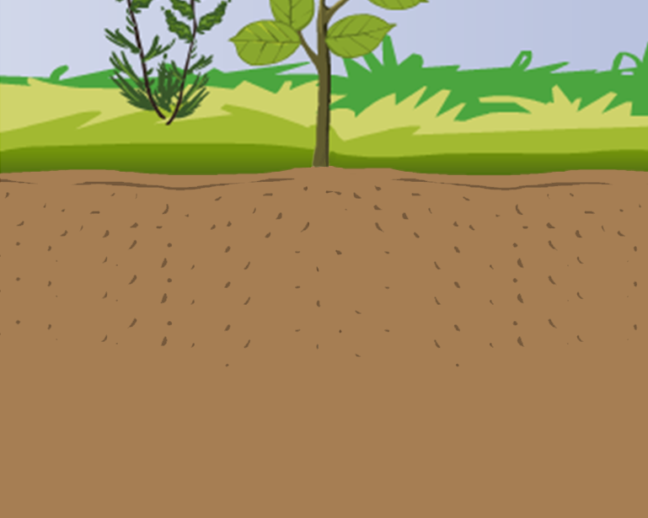
Gravitropism :
Root system of plant responds to stimulus of gravity

Slide 3
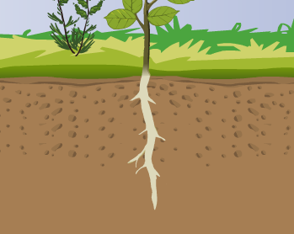


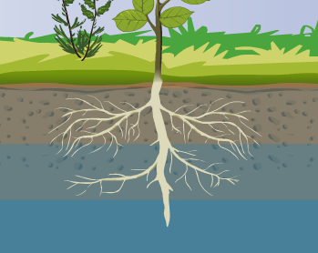
Hydrotropism :
Root system of plant responds to stimulus of water

Slide 4
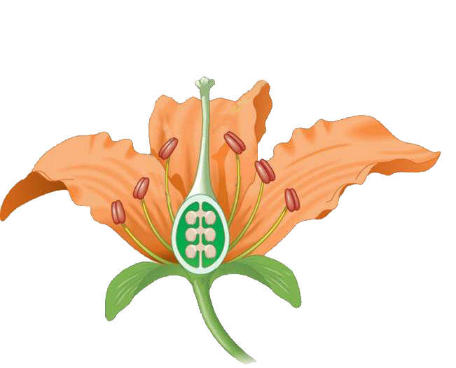
Chemotropism :
It is the movement of plant part in response to certain chemicals
Pollen grains
A pollen tube generates from stigma towards the ovule in response to the chemical
e.g. The growth of pollen tubes towards the ovules
A chemical is secreted from the ovule

Slide 5
Thank You

